Slide 1

DATA BASE MANAGEMENT SYSTEMS
1.Overview
‹#›
Overview: Unit 1
Notes:
‹#›

Slide 2
General Concepts
‹#›
Data
Known facts
Types: text, graphics, images, sound, videos
Information
Processed data
Database
Organized collection of logically inter-related data.
Database management system (DBMS)
Software package for defining and managing and facilitate access to database.
Examples: Proprietary: MS Access, MS SQL Server, DB2, Oracle, Sybase Open source: MySql, PostgreSQL
Database systems=Database +DBMS
1.Overview

Slide 3

Database Management System (DBMS)
‹#›
DBMS contains information about a particular enterprise
Collection of interrelated data
Set of programs to access the data
An environment that is both convenient and efficient to use
Database Applications:
Banking: all transactions
Airlines: reservations, schedules
Universities: registration, grades
Sales: customers, products, purchases
Online retailers: order tracking, customized recommendations
Manufacturing: production, inventory, orders, supply chain
Human resources: employee records, salaries, tax deductions
Databases touch all aspects of our lives
1.Overview

Slide 4
File System
‹#›
Characteristics:
Data is stored as records in regular files
Records usually have a simple structure and fixed number of fields
For fast access may support indexing of fields in the records
No mechanisms for relating data between files
One needs special programs in order to access and manipulate the data
1.Overview

Slide 5
Purpose of Database Systems
‹#›
In the early days, database applications were built directly on top of file systems
Drawbacks of using file systems to store data:
Data redundancy and inconsistency
Multiple file formats, duplication of information in different files
Difficulty in accessing data
Need to write a new program to carry out each new task
Data isolation — multiple files and formats
Integrity problems
Integrity constraints (e.g. account balance > 0) become “buried” in program code rather than being stated explicitly
Hard to add new constraints or change existing ones
1.Overview

Slide 6
Purpose of Database Systems (Cont.)
‹#›
Drawbacks of using file systems (cont.)
Atomicity of updates
Failures may leave database in an inconsistent state with partial updates carried out
Example: Transfer of funds from one account to another should either complete or not happen at all
Concurrent access by multiple users
Concurrent accessed needed for performance
Uncontrolled concurrent accesses can lead to inconsistencies
Example: Two people reading a balance and updating it at the same time
Security problems
Hard to provide user access to some, but not all, data
Database systems offer solutions to all the above problems
1.Overview

Slide 7
Advantages of a DBMS
‹#›
Data independence
Efficient data access
Data integrity & security
Data administration
Concurrent access, crash recovery
Reduced application development time
So why not use them always?
Expensive/complicated to set up & maintain
This cost & complexity must be offset by need
General-purpose, not suited for special-purpose tasks (e.g. text search!)
1.Overview

Slide 8
Database Types
‹#›
Type | Typical number of users | Typical architecture | Typical size
Personal | 1 | Desktop/Laptop/ PDA | MB
Workgroup | 5-25 | Client/server:2 tier | MB-GB
Department | 25-100 | Client/server:3 tier | GB
Enterprise | >100 | Client/server: distributed | GB-TB
Internet | >1000 | Web sever & application servers | MB-GB
1.Overview

Slide 9
Instances and Schemas
‹#›
Similar to types and variables in programming languages
Schema – the logical structure of the database
Example: The database consists of information about a set of customers and accounts and the relationship between them
Physical schema: database design at the physical level
Logical schema: database design at the logical level
Instance – the actual content of the database at a particular point in time
1.Overview

Slide 10
Data Independence
‹#›
Applications insulated from how data is structured and stored.
Logical data independence: Protection from changes in logical structure of data.
Physical data independence: Protection from changes in physical structure of data.
View 1
View 2
View 3
Conceptual Schema
Physical Schema
DB
1.Overview
Notes:
‹#›

Slide 11



3 Levels of Abstraction
Users
Views describe how users see the data.
Conceptual schema defines logical structure.
Physical schema describes the files and indexes used.
View 1
View 2
View 3
Conceptual Schema
Physical Schema
DB
‹#›
1.Overview
Notes:
‹#›
6

Slide 12
Levels of Abstraction
‹#›
Physical level: describes how a record (e.g., customer) is stored.
Logical level: describes data stored in database, and the relationships among the data.
type customer = record name : string; street : string; city : integer; end;
View level: application programs hide details of data types. Views can also hide information (e.g., salary) for security purposes.
1.Overview

Slide 13
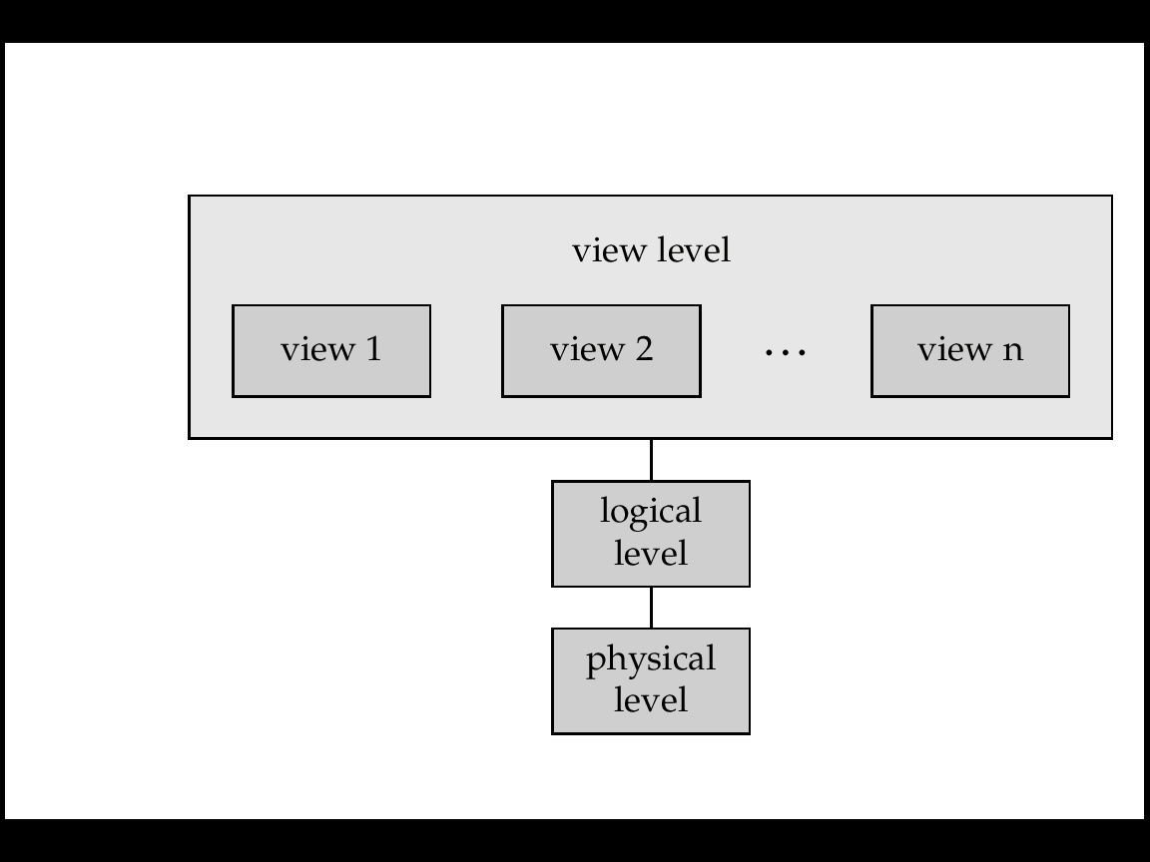
An Architecture For A Database System
‹#›
View of Data
1.Overview

Slide 14
Example:University Database
‹#›
Conceptual schema(logical):
Students(sid: string, name: string, login: string, age: integer, gpa:real)
Courses(cid: string, cname:string, credits:integer)
Enrolled(sid:string, cid:string, grade:string)
Physical schema:
Relations stored as unordered files.
Index on first column of Students.
External Schema (View):
Course_info(cid:string,enrollment:integer
View 1
View 2
View 3
Conceptual Schema
Physical Schema
DB
1.Overview
Notes:
‹#›
7

Slide 15
Data Models
‹#›
A collection of tools for describing
Data
Data relationships
Data semantics
Data constraints
Relational model(RDBMS)
Entity-Relationship data model (mainly for database design)
Object-based data models (Object-oriented and Object-relational)
Semi structured data model (XML)
Other older models:
Network model
Hierarchical model
1.Overview

Slide 16
Database Models
‹#›
Flat files ‘60
Hierarchical ‘60
Network ‘70
Relational ‘80
Object oriented ‘90
Object relational ‘90
Web enabled ‘90
1.Overview

Slide 17
DBMS ARCHITECTURE
‹#›
1.Overview

Slide 18
Structure of a DBMS
These layers
must consider
concurrency
control and
recovery
‹#›
A typical DBMS has a layered architecture.
Each database system has its own variations.
Query Optimization
and Execution
Relational Operators
Files and Access Methods
Buffer Management
Disk Space Management
DB
1.Overview
Notes:
‹#›
22

Slide 19
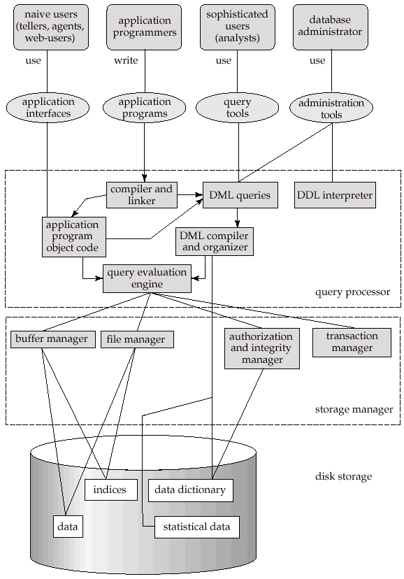
Overall System Structure
‹#›
1.Overview

Slide 20
Transaction Management
‹#›
A transaction is a collection of operations that performs a single logical function in a database application.
Transaction-management component ensures that the database remains in a consistent (correct) state despite system failures (e.g., power failures and operating system crashes) and transaction failures.
Concurrency-control manager controls the interaction among the concurrent transactions, to ensure the consistency of the database.
1.Overview

Slide 21
Storage Management
‹#›
Storage manager is a program module that provides the interface between the low-level data stored in the database and the application programs and queries submitted to the system.
The storage manager is responsible to the following tasks:
interaction with the file manager
efficient storing, retrieving and updating of data
1.Overview

Slide 22
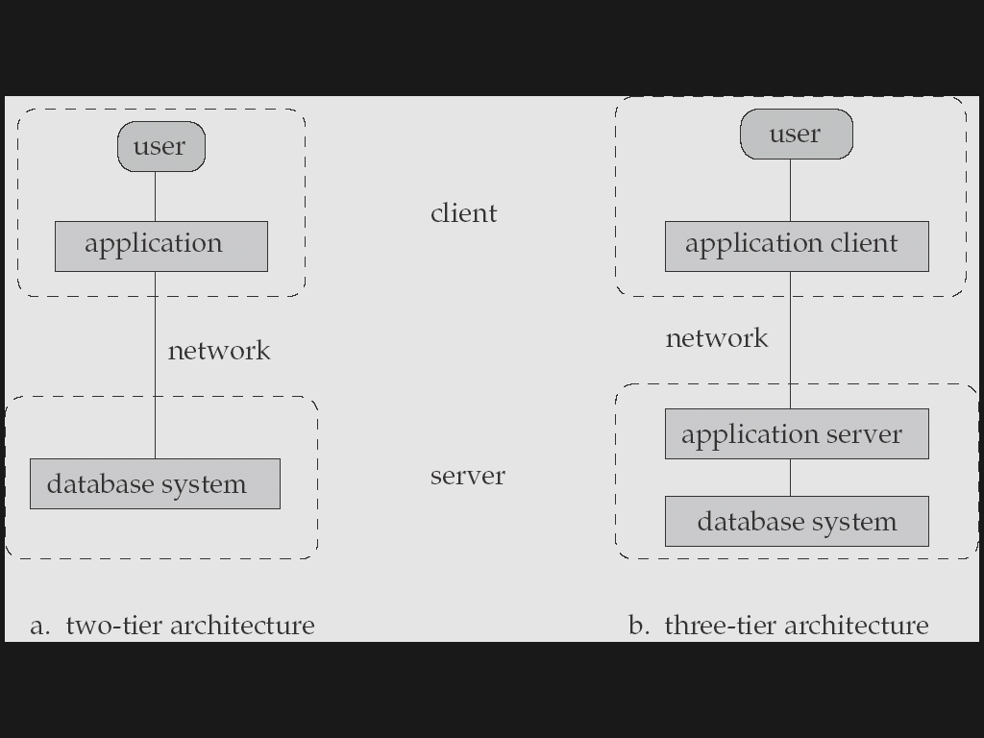
Database Application Architectures
‹#›
Old
Modern
(web browser)
Two-tier architecture: E.g. client programs using ODBC/JDBC to communicate with a database
Three-tier architecture: E.g. web-based applications, and applications built using “middleware”
1.Overview
Notes:
‹#›

Slide 23
Database Users
‹#›
Users are differentiated by the way they expect to interact with the system
Application programmers – interact with system through DML calls, they will write Application programs Eg: computer professionals
Sophisticated users – interacts with database without write application programs.eg: analysts
Specialized users – write specialized database applications that do not fit into the traditional data processing framework.
Naïve users – invoke one of the permanent application programs that have been written previously .E.g. people accessing database over the web, bank tellers, clerical staff
1.Overview

Slide 24
Database Administrator (DBA)
‹#›
Database administrator's Responsibilities include:
Design logical/physical schemas
Storage structure and access method definition
Schema and physical organization modification
Granting user authority to access the database
Specifying integrity constraints
Routine maintenance
Monitoring performance and responding to changes in requirements.
Periodically backing up the database.
Ensuring Data availability, crash recovery.
1.Overview
Notes:
‹#›

Slide 25
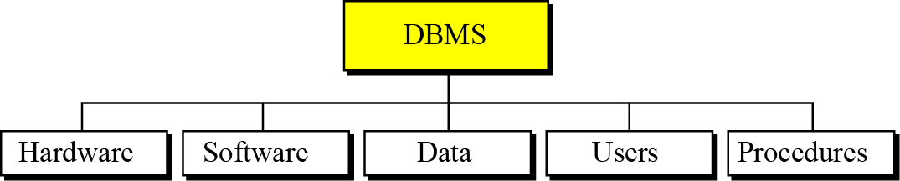
DATABASE MANAGEMENT SYSTEMS
‹#›
A database management system (DBMS) defines, creates and maintains a database. The DBMS also allows controlled access to data in the database. A DBMS is a combination of five components: hardware, software, data, users and procedures.
1.Overview

Slide 26
DBMS Components
‹#›
Hardware: The hardware is the physical computer system that allows access to data.
Software: The software is the actual program that allows users to access, maintain and update data. In addition, the software controls which user can access which parts of the data in the database.
Confidentiality: The data in a database is stored physically on the storage devices. In a database, data is a separate entity from the software that accesses it .
1.Overview

Slide 27
DBMS Components
‹#›
Users: In a DBMS, the term users has a broad meaning. We can divide users into two categories: end users and application programs.
Procedures: The last component of a DBMS is a set of procedures or rules that should be clearly defined and followed by the users of the database.
1.Overview

Slide 28
Conventional Data Models
‹#›
Hierarchical database model
Network database model
1.Overview

Slide 29
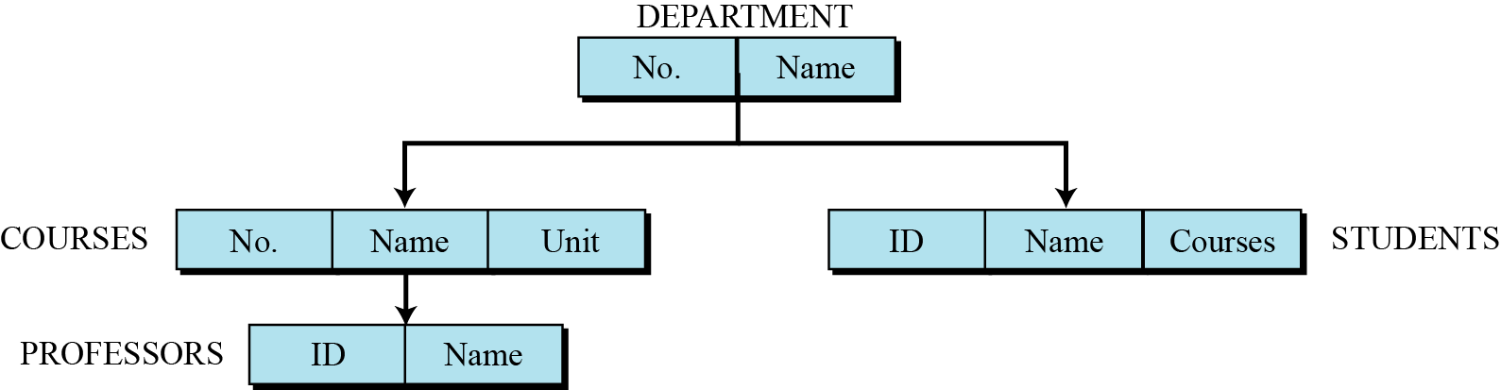
Hierarchical Database model
‹#›
In the hierarchical model, data is organized as an inverted tree. Each entity has only one parent but can have several children. At the top of the hierarchy, there is one entity, which is called the root.
An example of the hierarchical model representing a College
1.Overview

Slide 30
Hierarchical Database model
‹#›
The advantage of hierarchical databases is that
they can be accessed and updated rapidly because the tree-like structure and the relationships between records are defined in advance.
However, this feature is a two-edged sword.
The disadvantage of this type of database structure is that each child in the tree may have only one parent, and relationships or linkages between children are not permitted, even if they make sense from a logical standpoint. Hierarchical databases are so rigid in their design that adding a new field or record requires that the entire database be redefined.
1.Overview

Slide 31
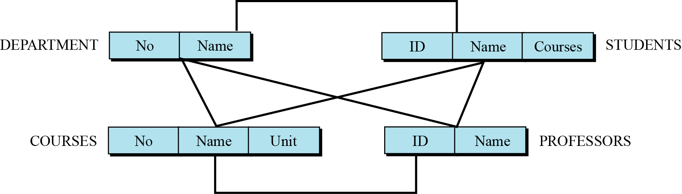
Network database model
‹#›
In the network model, the entities are organized in a graph, in which some entities can be accessed through several paths.
An example of the Network database model representing a College
1.Overview

Slide 32
Network database model
‹#›
The advantage
Network databases are principally used on mainframe computers.
Since more connections can be made between different types of data, network databases are considered more flexible.
The disadvantage
However, two limitations must be considered when using this kind of database. Similar to hierarchical databases, network databases must be defined in advance. There is also a limit to the number of connections that can be made between records.
1.Overview

Slide 33
Entity-relationship models (ERM)
‹#›
In this step, the database designer creates an entity-relationship (E-R) diagram to show the entities for which information needs to be stored and the relationship between those entities. E-R diagrams uses several geometric shapes, but we use only a few of them here.
Rectangles represent entity sets
Ellipses represent attributes
Diamonds represent relationship sets
Lines link attributes to entity sets and link entity sets to relationships sets
1.Overview

Slide 34
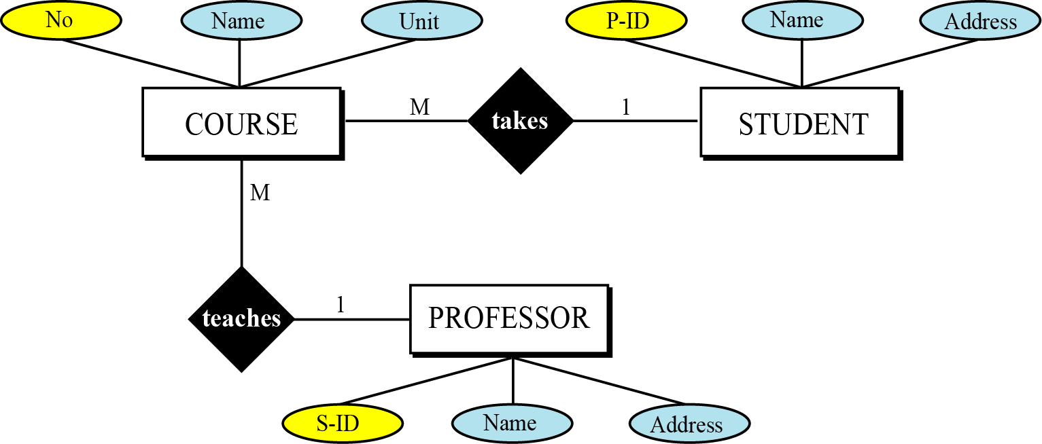
A Very Simple E-R Diagram
‹#›
An example of the Entity-relationship models representing a College.
1.Overview

Slide 35
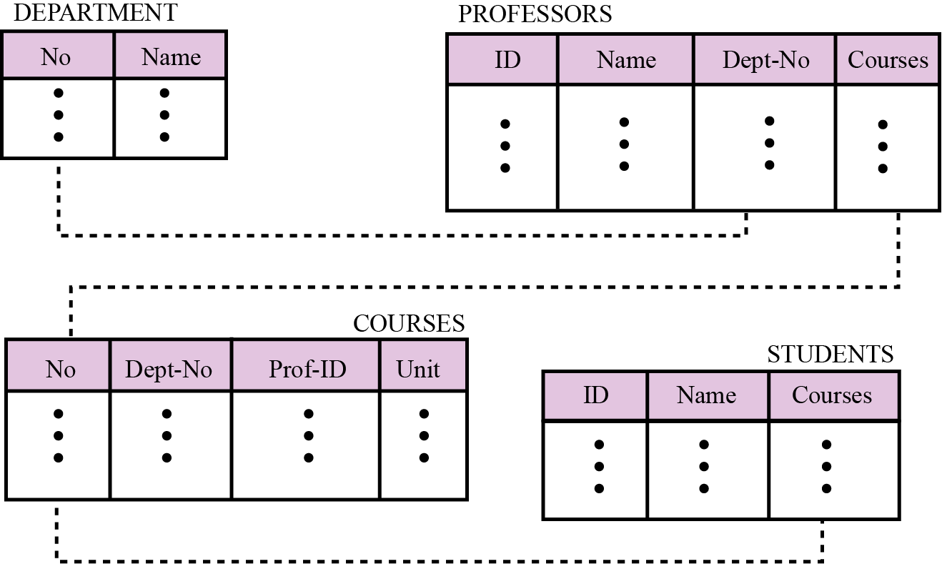
Relational database model
‹#›
In the relational model, data is organized in two-dimensional tables called relations. The tables or relations are, however, related to each other, as we will see shortly.
An example of the Relational database model representing a College
1.Overview

Slide 36

Thank you
‹#›
DBMS R&D represents a broad, fundamental branch of the science of computation
1.Overview
Notes:
‹#›

